Slide 1


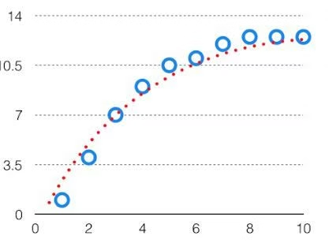
Understanding Bias and Variance in Machine Learning
In machine learning, prediction accuracy depends on understanding and managing two critical errors: bias and variance. Finding the optimal balance between these errors—known as the bias-variance tradeoff—is essential for creating models that perform well on both training and new data.

Slide 2

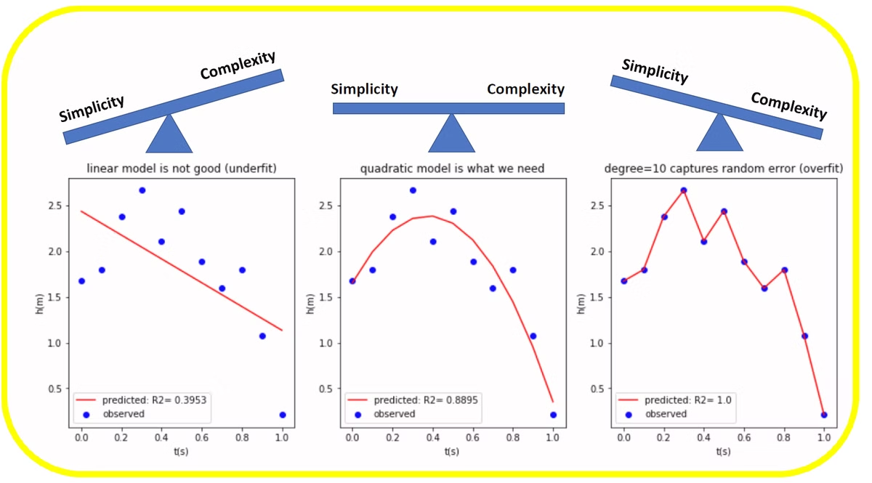
The Importance of Prediction Errors
1
Foundation of Model Accuracy
2
Regularization Connection
Understanding prediction errors is fundamental to creating accurate machine learning algorithms. These errors determine how well your model will perform on both seen and unseen data.
The bias-variance tradeoff directly influences the selection of regularization constants, which help control model complexity and prevent overfitting.
3
Preventing Modeling Pitfalls
A proper understanding of bias and variance helps avoid the twin problems of underfitting (too simple) and overfitting (too complex) when training algorithms.

Slide 3
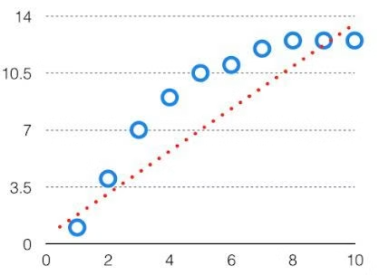
What is Bias?
Bias represents the difference between the predicted values of a machine learning model and the correct values. High bias results in large errors in both training and testing data.
When a model has high bias, it produces predictions in a simplified, often linear format that fails to capture the true complexity of the underlying data patterns. This leads to underfitting—where the model is too simplistic to represent the actual relationships in the data.
A high-bias model typically uses a simple hypothesis, such as a linear equation. While easy to interpret, such models often miss important patterns in the data, resulting in poor performance across all datasets.

Slide 4
High Bias: The Underfitting Problem
Simplified Representation
Linear Hypotheses
Consistent Errors
High-bias models create oversimplified representations of data, often appearing as straight lines that miss the true patterns in the dataset.
These models typically use linear or very simple hypotheses that cannot capture complex relationships in the data.
High-bias models perform poorly on both training and testing data, showing consistently high error rates across all datasets.

Slide 5
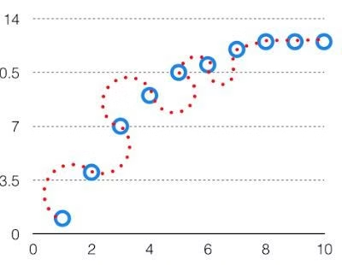
What is Variance?
Variance refers to the variability of model predictions for a given data point, indicating how widely spread the predictions are. A model with high variance creates an overly complex fit to the training data.
While high-variance models perform exceptionally well on training data, they struggle to generalize to new, unseen data. This phenomenon is known as overfitting—where the model essentially memorizes the training data rather than learning the underlying patterns.
High-variance models typically use complex hypotheses with high-degree equations. These models capture noise in the training data as if it were a meaningful pattern, leading to poor performance on new data.

Slide 6



High Variance: The Overfitting Problem
Excessive Detail
Complex Hypotheses
Performance Gap
High-variance models pay too much attention to minor fluctuations and noise in the training data, treating them as significant patterns.
These models use complex, high-order equations that create intricate curves to fit every data point in the training set.
High-variance models show excellent performance on training data but significantly worse performance on testing or validation data.

Slide 7

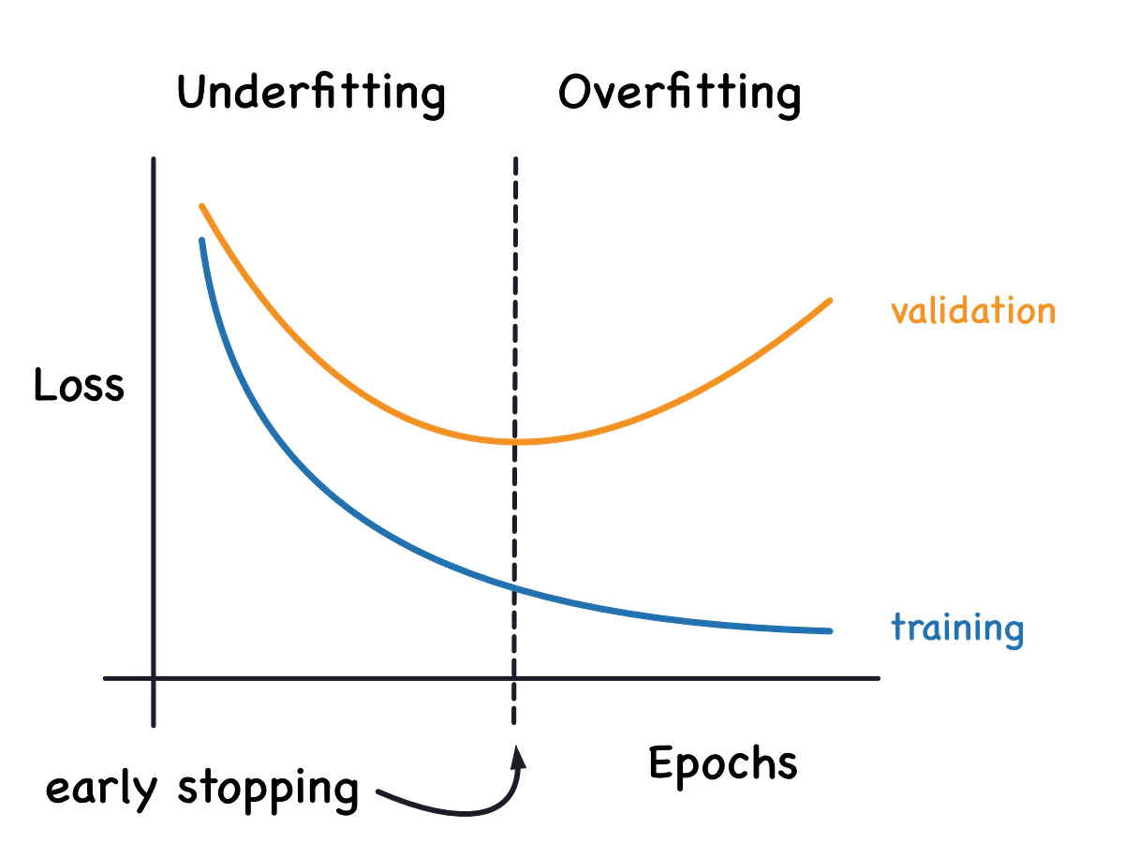
Comparing Bias and Variance
Characteristic
High Bias
High Variance
Model Complexity
Too simple
Too complex
Hypothesis Type
Linear, low-order
High-order, intricate
Training Performance
Poor
Excellent
Testing Performance
Poor
Poor
Problem Type
Underfitting
Overfitting

Slide 8
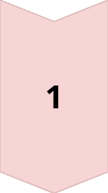

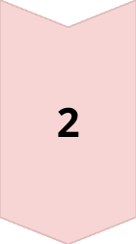
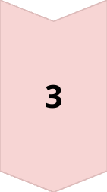
The Bias-Variance Tradeoff
Too Simple
Algorithms with linear equations may have high bias and low variance, leading to underfitting and consistent errors across all datasets.
Balanced Complexity
The ideal model finds the sweet spot between simplicity and complexity, balancing bias and variance to perform well on both training and new data.
Too Complex
Algorithms with high-degree equations may have high variance and low bias, leading to overfitting and poor performance on new data.

Slide 9
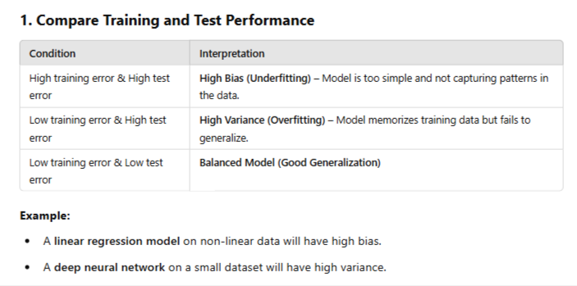

Slide 10
Mathematical Representation of the Tradeoff
Total Error Formula
The total error of a model can be decomposed into bias, variance, and irreducible error components, as shown in the equation: Total Error = Bias² + Variance + Irreducible Error.
Bias Component
Bias represents how far off the model's predictions are from the true values on average. Reducing bias typically requires more complex models.
Variance Component
Variance represents how much the model's predictions fluctuate for different training sets. Reducing variance typically requires simpler models or more training data.

Slide 11

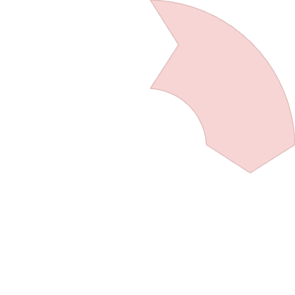


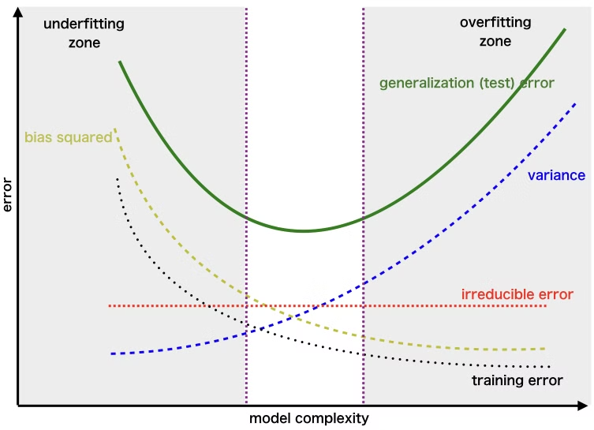
Visualizing the Error-Complexity Relationship
Low Complexity
1
Optimal Complexity
Simple models have high bias but low variance.
2
The sweet spot minimizes total error.
Error Assessment
4
High Complexity
Evaluate total error to find optimal model.
3
Complex models have low bias but high variance.

Slide 12
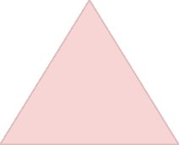
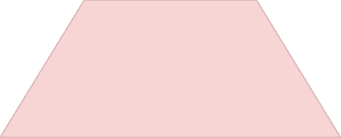
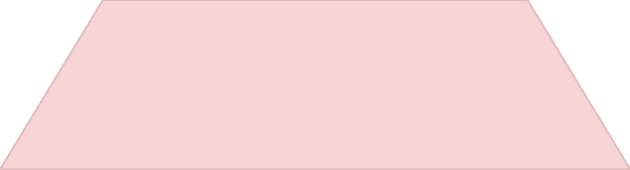
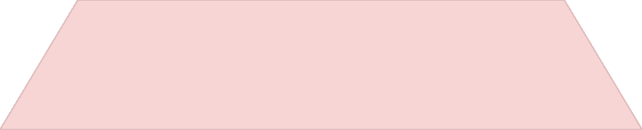
Finding the Optimal Tradeoff Point
Optimal Model
1
Balanced bias and variance
Cross-Validation
2
Testing performance on multiple data splits
Regularization Techniques
3
Methods to control model complexity
Model Selection Criteria
4
AIC, BIC, adjusted R-squared

Slide 13
Regularization: A Key Tool for the Tradeoff
What is Regularization?
L1 Regularization (Lasso)
L2 Regularization (Ridge)
Regularization adds a penalty term to the loss function that increases with model complexity, helping to prevent overfitting by discouraging unnecessarily complex models.
Adds the absolute value of coefficients as a penalty term, which can lead to sparse models by forcing some coefficients to zero, effectively performing feature selection.
Adds the squared value of coefficients as a penalty term, which shrinks all coefficients toward zero but rarely sets them exactly to zero, maintaining all features but with reduced impact.

Slide 14

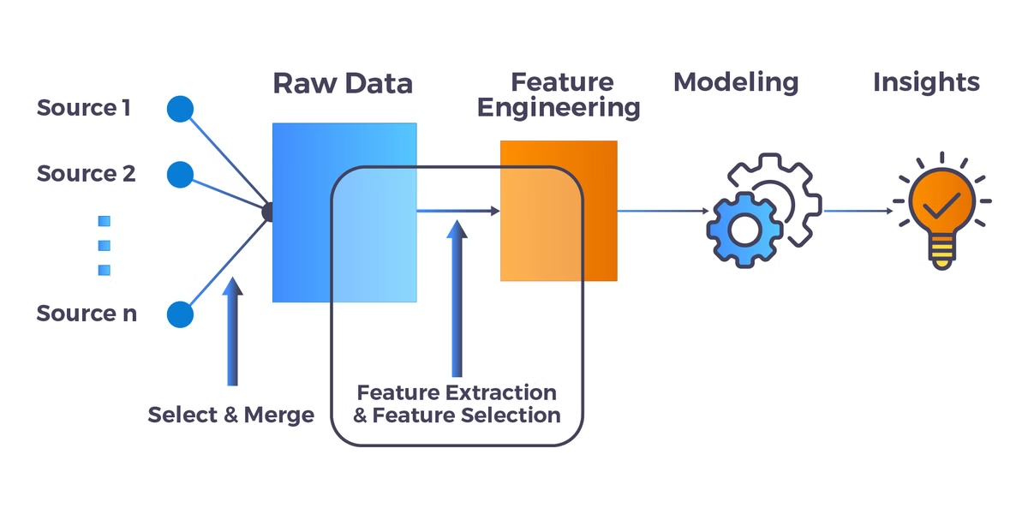
Practical Strategies to Manage Bias
1
Increase Model Complexity
Add more features, use polynomial features, or implement more complex algorithms like decision trees or neural networks instead of linear models.
2
Feature Engineering
Create new features that better capture the underlying patterns in the data, such as interaction terms or domain-specific transformations.
3
Reduce Regularization
If using regularization techniques, decrease the regularization parameter to allow the model more flexibility to fit the training data.
4
Ensemble Methods
Combine multiple simple models to create a more powerful composite model that can capture complex patterns while maintaining interpretability.

Slide 15
Practical Strategies to Manage Variance
Collect More Data
1
Larger training datasets help models generalize better
Feature Selection
2
Remove irrelevant or redundant features
Increase Regularization
3
Add stronger penalties for model complexity
Early Stopping
4
Halt training before overfitting occurs

Slide 16
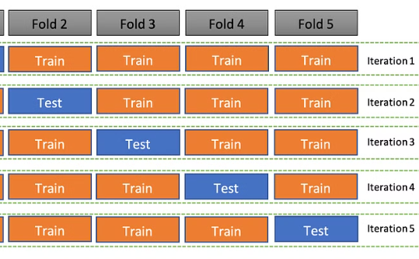
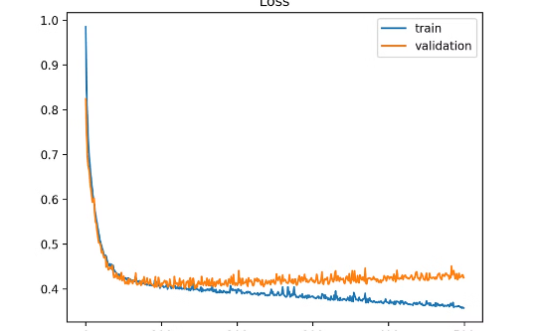
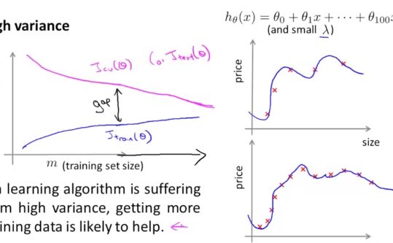
Cross-Validation: Testing the Tradeoff
K-Fold Cross-Validation
Learning Curves
Validation Curves
Divide data into k subsets, train on k-1 folds and validate on the remaining fold, rotating through all combinations. This provides a robust estimate of model performance across different data splits.
Plot training and validation error against training set size to diagnose bias and variance issues. High training error indicates high bias, while a large gap between training and validation error suggests high variance.
Plot training and validation error against a model hyperparameter (like regularization strength) to find the optimal setting that balances bias and variance.

Slide 17
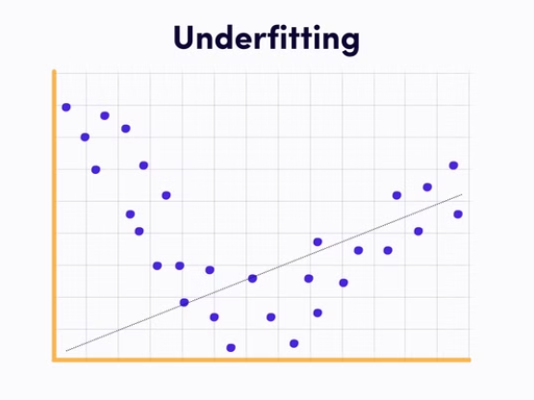
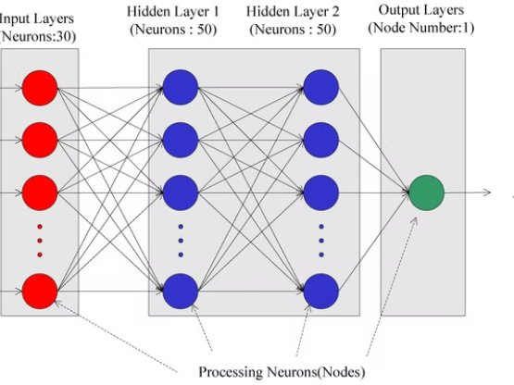
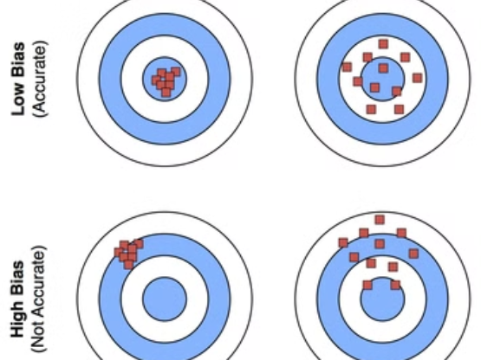
Real-World Examples of Bias-Variance Tradeoff
Different algorithms naturally balance bias and variance differently. Linear models tend toward high bias, while decision trees often suffer from high variance. Ensemble methods like random forests and regularized neural networks can achieve better tradeoffs by combining multiple models or controlling complexity.
The right choice depends on your specific problem, data characteristics, and performance requirements. Sometimes a slightly biased model is preferable for its stability and interpretability.

Slide 18

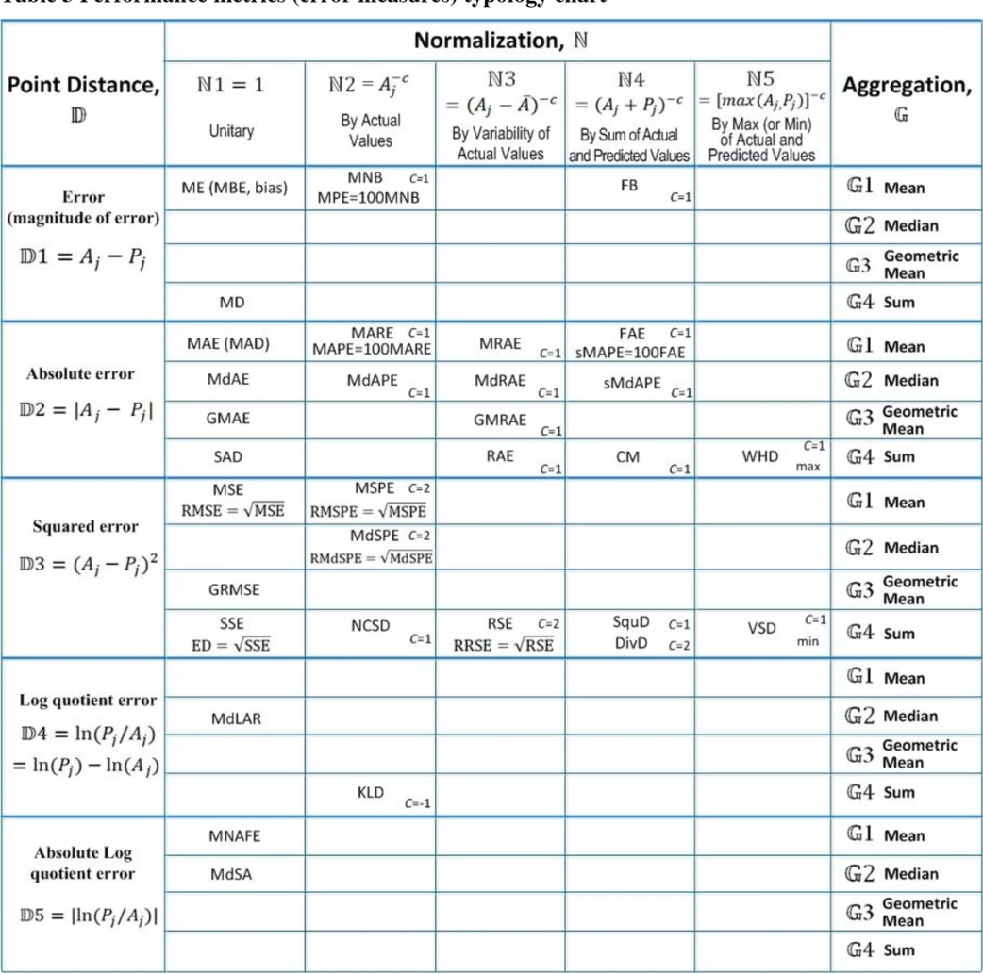
Measuring Bias and Variance in Practice
MSE
Mean Squared Error
The primary metric for quantifying total prediction error, combining both bias and variance components.
R²
Coefficient of Determination
Measures the proportion of variance explained by the model, helping identify underfitting.
AIC
Akaike Information Criterion
Balances model fit against complexity to prevent overfitting and find optimal tradeoff point.
RMSE
Root Mean Squared Error
Provides error measurement in the same units as the target variable for interpretability.

Slide 19
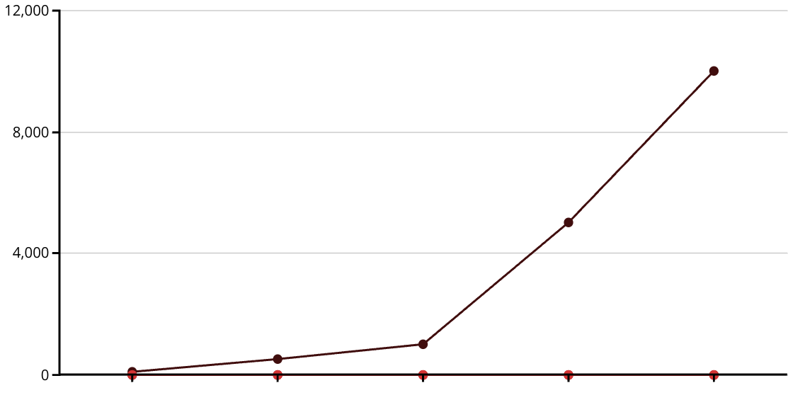
The Impact of Sample Size on Bias-Variance Tradeoff
Training Set Size
Bias
Variance
Total Error
As training set size increases, variance typically decreases while bias remains relatively constant. This is because larger datasets provide more information about the true underlying patterns, reducing the model's sensitivity to individual data points.
With sufficient data, even complex models can achieve low variance without overfitting, allowing you to use more sophisticated algorithms that can better capture the true relationships in the data.

Slide 20
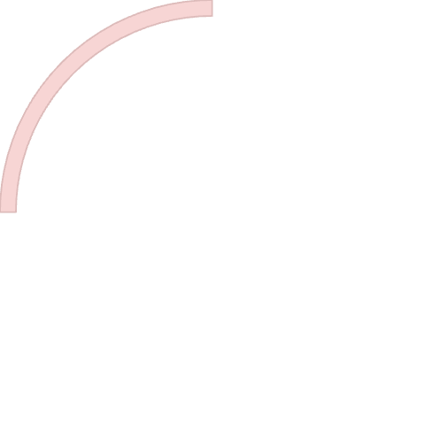
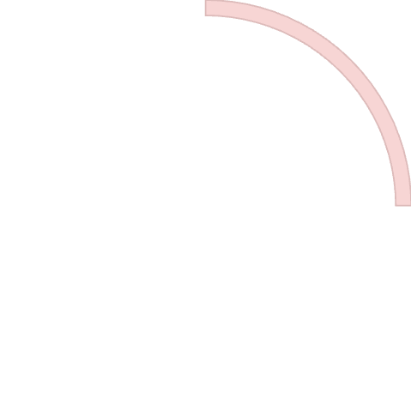
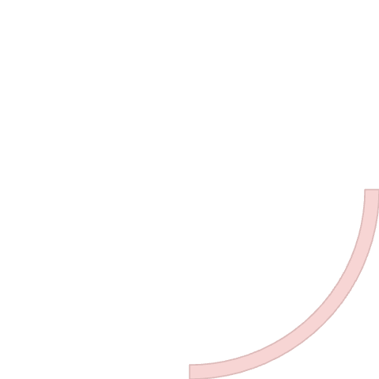

Bias-Variance Tradeoff Across Different Algorithms
Linear Models
Decision Trees
High bias, low variance. Simple and interpretable but may underfit complex data. Examples include linear regression and logistic regression.
Low bias, high variance. Can capture complex non-linear relationships but prone to overfitting, especially with deep trees.
1
2
Neural Networks
Ensemble Methods
Flexible bias-variance tradeoff. Can be adjusted through architecture complexity, regularization, and training duration to find optimal balance.
Balanced bias and variance. Random forests and gradient boosting combine multiple models to reduce variance while maintaining low bias.
4
3

Slide 21

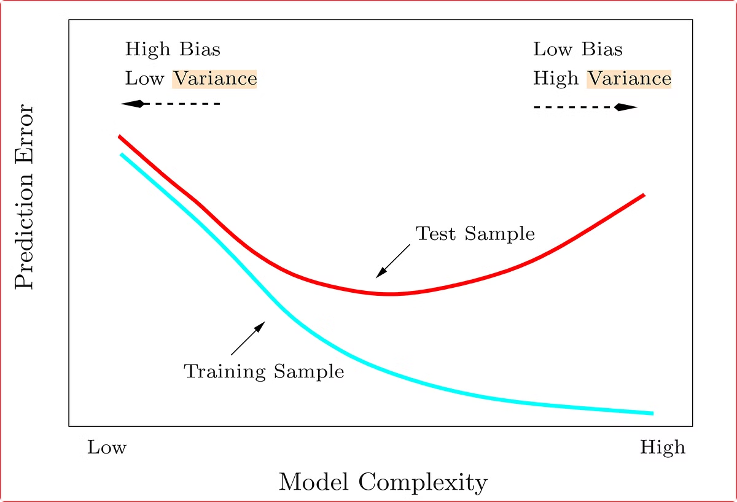
Key Takeaways: Mastering the Bias-Variance Tradeoff
1
Understand the Fundamental Tradeoff
Recognize that bias and variance represent opposing forces in model development. Reducing one typically increases the other, making the tradeoff unavoidable but manageable.
2
Diagnose Your Model's Position
Use cross-validation, learning curves, and error decomposition to determine whether your model suffers more from bias or variance, then apply the appropriate remedies.
3
Apply Regularization Strategically
Leverage regularization techniques to control model complexity, finding the optimal regularization parameter through systematic experimentation and validation.
4
Balance Performance with Interpretability
Consider your specific application needs when selecting a model. Sometimes a slightly biased but more interpretable model is preferable to a perfectly fitted black box.

